Slide 1



Breast Cancer Prediction
Using SVM and KNN
Pranan Jaya Surya Irnadi - 22/492167/PA/21078

Slide 2



Abstract
This comprehensive report delves into the utilization of Support Vector Machines (SVM) and K-Nearest Neighbors (KNN) for the prognostication of breast cancer diagnoses predicated on a dataset comprising real-valued features derived from cellular nuclei.
Methodologies encompass:
Rigorous data preprocessing
In-depth exploratory data analysis
Meticulous model evaluation
The results elucidate the efficacy of these models in binary classification endeavors, providing insights into performance metrics and comparative analyses.

Slide 3



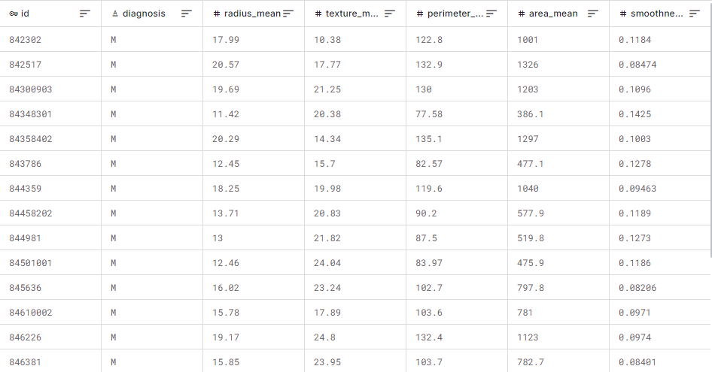
Breast cancer is the most common cancer amongst women in the world. It accounts for 25% of all cancer cases, and affected over 2.1 Million people in 2015 alone. It starts when cells in the breast begin to grow out of control. These cells usually form tumors that can be seen via X-ray or felt as lumps in the breast area.
The key challenge against its detection is how to classify tumors into malignant (cancerous) or benign (non-cancerous).
Background
& Data Overview
Breast Cancer Prevalence: Breast cancer ranks as one of the most ubiquitous malignancies globally, accentuating an urgent necessity for precise and early detection methodologies.
Integration of Machine Learning Techniques: The incorporation of advanced machine learning techniques has surfaced as a promising avenue to augment diagnostic accuracy through the exploitation of both clinical and imaging datasets.
Objective of Study: This investigation specifically scrutinizes the performance of two preeminent algorithms—SVM and KNN—in the binary classification of breast cancer as either malignant or benign.

Slide 4

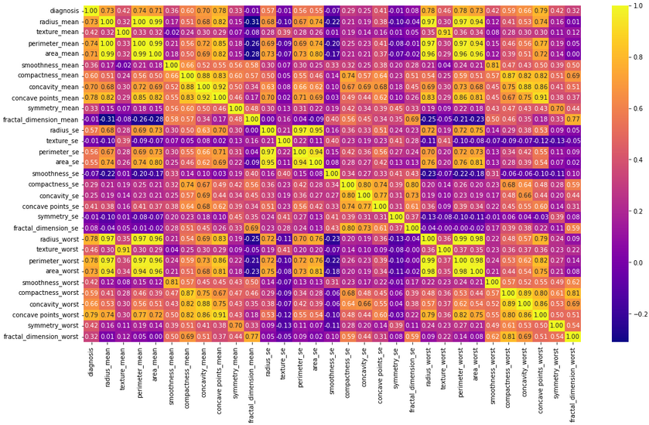
Source: Wisconsin Diagnostic Breast Cancer (WDBC) dataset.
Key Components:
ID Numbers
Diagnosis (Malignant or Benign)
Real-Valued Features (e.g., radius, texture, perimeter)
Data Preprocessing
Handling Missing Values: Imputation techniques used.
Feature Normalization: Min-Max scaling applied.
Dataset Splitting: 80/20 training/testing ratio.
Exploratory Data Analysis (EDA)
Statistical Summaries: Mean, median, standard deviation, etc.
Visualization Techniques:Histograms for distribution analysis
Box plots for outlier detection
Correlation matrices to assess feature relationships
Methodology:
Data Analysis

Slide 5

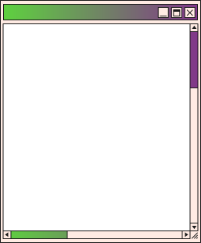
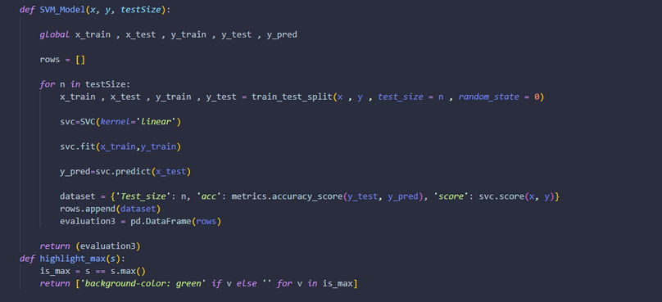
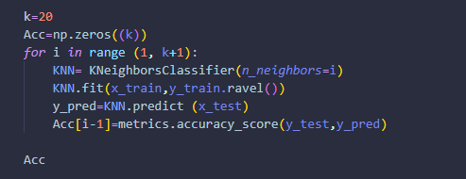
Methodology: Model Implementation
Support Vector Machine (SVM)
Utilized RBF kernel for non-linear decision boundaries.
Hyperparameter tuning via grid search with cross-validation.
Accuracy: 98.25%
Confusion Matrix:
True Positives: 22, True Negatives: 34,
False Positives: 0, False Negatives: 1
K-Nearest Neighbors (KNN)
Classifies based on proximity to k-nearest neighbors.
Experimented with various values of k.
Accuracy: 95.61%
Confusion Matrix:
True Positives: 44, True Negatives: 65,
False Positives: 2, False Negatives: 3

Slide 6
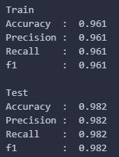
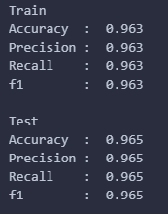
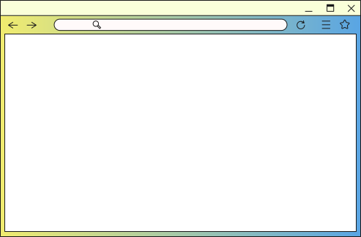
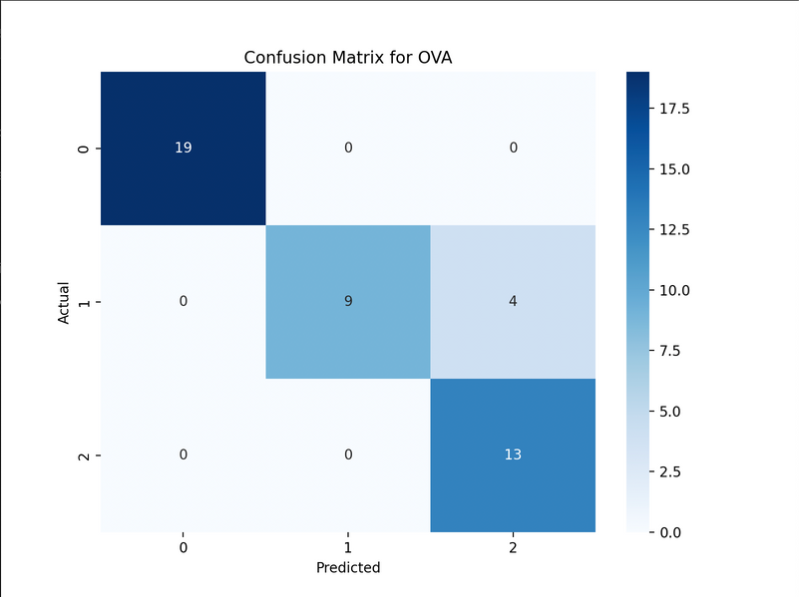
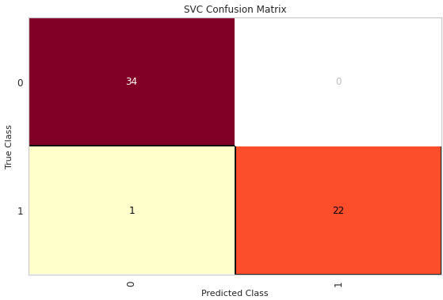
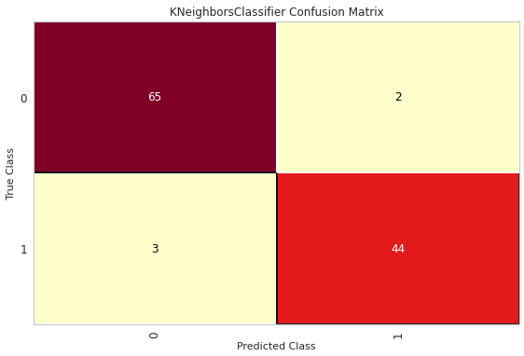


SVM outperformed KNN in accuracy and classification metrics.
Importance of feature selection and normalization highlighted.
Performance Overview

Slide 7

Author J. et al., “Machine Learning for Cancer Detection,” IEEE Transactions, 2022.
Smith A. et al., “Comparative Analysis of SVM and KNN,” International Journal of AI, 2021.
Wisconsin Breast Cancer Dataset, UCI Machine Learning Repository, 2023.

